Slide 1


Slide 2


Slide 3
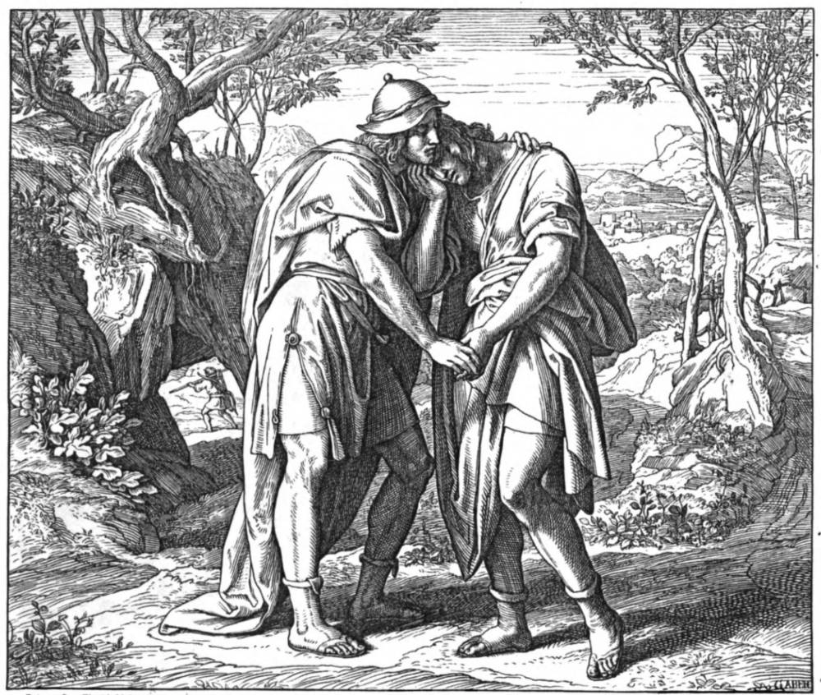
Loyal Friendship
1 Samuel 20

Slide 4
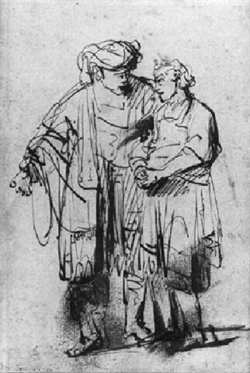
The Problem: Find out why Saul wants to kill David.
Picture: David is a type of Christ.

Slide 5
Mark 15:12-14 And Pilate answered and said again unto them, What will ye then that I shall do unto him whom ye call the King of the Jews? 13 And they cried out again, Crucify him. 14 Then Pilate said unto them, Why, what evil hath he done? And they cried out the more exceedingly, Crucify him.

Slide 6
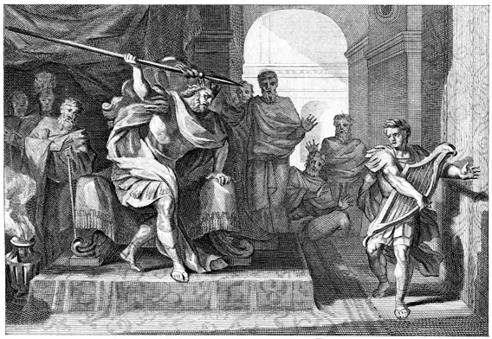
The Problem: Find out why Saul wants to kill David.
Picture: David is a type of Christ.
You are supposed to be a type of Christ!
If you follow God, some will hate you for it.
John 15:18 If the world hate you, ye know that it hated me before it hated you.

Slide 7
1 Samuel 19:1-2 And Saul spake to Jonathan his son, and to all his servants, that they should kill David. 2 But Jonathan Saul's son delighted much in David: and Jonathan told David, saying, Saul my father seeketh to kill thee: now therefore, I pray thee, take heed to thyself until the morning, and abide in a secret place, and hide thyself:
Jonathan is wishfully thinking!

Slide 8
Principle: Loyal friends help when there is true need!
Loyalty can require helping another even when it hurts you.

Slide 9
John 15:13 Greater love hath no man than this, that a man lay down his life for his friends.
Matthew 20:28 Even as the Son of man came not to be ministered unto, but to minister, and to give his life a ransom for many.

Slide 10
Luke 10:34-37 And went to him, and bound up his wounds, pouring in oil and wine, and set him on his own beast, and brought him to an inn, and took care of him. 35 And on the morrow when he departed, he took out two pence, and gave them to the host, and said unto him, Take care of him; and whatsoever thou spendest more, when I come again, I will repay thee. 36 Which now of these three, thinkest thou, was neighbour unto him that fell among the thieves? 37 And he said, He that shewed mercy on him. Then said Jesus unto him, Go, and do thou likewise.

Slide 11
Romans 15:1-2 We then that are strong ought to bear the infirmities of the weak, and not to please ourselves. 2 Let every one of us please his neighbour for his good to edification.
Proverbs 31:20 She stretcheth out her hand to the poor; yea, she reacheth forth her hands to the needy.

Slide 12
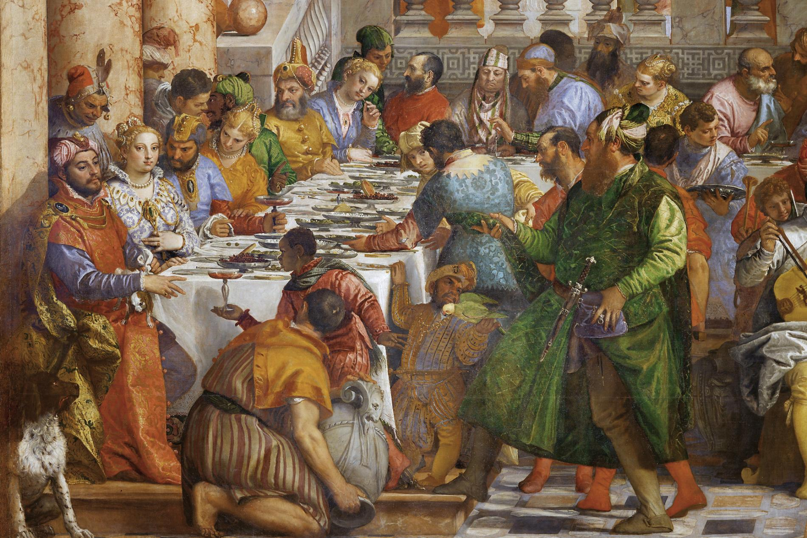
The Plan: Find out whether
Saul is in murder mode.
A new moon meant a new month in the Jewish calendar – that meant an observance and a sacrificial meal. See vs 24-29
Psalm 81:3 Blow up the trumpet in the new moon, in the time appointed, on our solemn feast day.

Slide 13
Principle: Remind your friends of their VALUE to you.

Slide 14
Matthew 16:23 But he turned, and said unto Peter, Get thee behind me, Satan: thou art an offence unto me: for thou savourest not the things that be of God, but those that be of men.

Slide 15
1 Samuel 23:14-18 And David abode in the wilderness in strong holds, and remained in a mountain in the wilderness of Ziph. And Saul sought him every day, but God delivered him not into his hand. 15 And David saw that Saul was come out to seek his life: and David was in the wilderness of Ziph in a wood. 16 And Jonathan Saul's son arose, and went to David into the wood, and strengthened his hand in God. 17 And he said unto him, Fear not: for the hand of Saul my father shall not find thee; and thou shalt be king over Israel, and I shall be next unto thee; and that also Saul my father knoweth. 18 And they two made a covenant before the LORD: and David abode in the wood, and Jonathan went to his house.

Slide 16
Luke 14:11 For whosoever exalteth himself shall be abased; and he that humbleth himself shall be exalted.

Slide 17
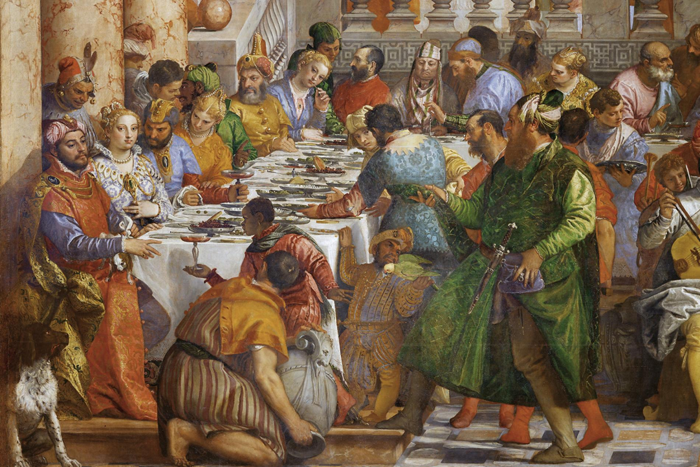
The Pitiful Reality: David was right.
Saul assumed that David wasn’t ceremonially unclean.
Saul is a prophet. David will replace him.
“religious experiences do not necessarily change your character”
“spiritual insight doesn’t necessarily mean anything either.”

Slide 18
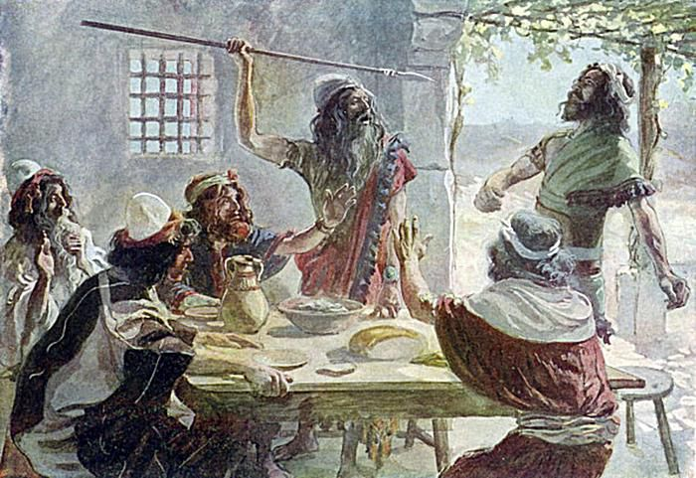

Slide 19
Isaiah 41:10 Fear thou not; for I am with thee: be not dismayed; for I am thy God: I will strengthen thee; yea, I will help thee; yea, I will uphold thee with the right hand of my righteousness.
James 4:7 Submit yourselves therefore to God. Resist the devil, and he will flee from you.
1 Corinthians 10:13 There hath no temptation taken you but such as is common to man: but God is faithful, who will not suffer you to be tempted above that ye are able; but will with the temptation also make a way to escape, that ye may be able to bear it.

Slide 20
Ephesians 3:16 That he would grant you, according to the riches of his glory, to be strengthened with might by his Spirit in the inner man;
1 Peter 5:7-10 Casting all your care upon him; for he careth for you. 8 Be sober, be vigilant; because your adversary the devil, as a roaring lion, walketh about, seeking whom he may devour: 9 Whom resist stedfast in the faith, knowing that the same afflictions are accomplished in your brethren that are in the world. 10 But the God of all grace, who hath called us unto his eternal glory by Christ Jesus, after that ye have suffered a while, make you perfect, stablish, strengthen, settle you.

Slide 21
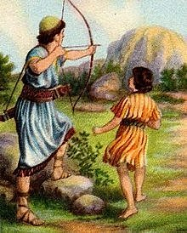
The Parting: David is now a fugitive.
Note Jonathan’s VS Saul’s will.
Godly vs Self focused.

Slide 22
Acts 5:27-29 And when they had brought them, they set them before the council: and the high priest asked them, 28 Saying, Did not we straitly command you that ye should not teach in this name? and, behold, ye have filled Jerusalem with your doctrine, and intend to bring this man's blood upon us. 29 Then Peter and the other apostles answered and said, We ought to obey God rather than men.

Slide 23

The Parting: David is now a fugitive.
Note Jonathan’s VS Saul’s will. Godly vs Self focused.
Loyalty key: Jonathan kept his promise to David! If you cannot keep your word, don’t give it.

Slide 24
Numbers 30:2 If a man vow a vow unto the LORD, or swear an oath to bind his soul with a bond; he shall not break his word, he shall do according to all that proceedeth out of his mouth.
Matthew 5:37 But let your communication be, Yea, yea; Nay, nay: for whatsoever is more than these cometh of evil.

Slide 25
Titus 2:8 Sound speech, that cannot be condemned; that he that is of the contrary part may be ashamed, having no evil thing to say of you.
1 Peter 2:21-22 For even hereunto were ye called: because Christ also suffered for us, leaving us an example, that ye should follow his steps: 22 Who did no sin, neither was guile found in his mouth:

Slide 26
John 15:13 Greater love hath no man than this, that a man lay down his life for his friends.

Slide 27
Loyal Friendship
1 Samuel 20

